Slide 1
Senior project final presentation, fall 2015
Team: Ingrid troche
Mentor: Mario Eraso
Instructor: Masoud Sadjadi
School of Computing and information Sciences
Florida International University

Slide 2
Project dEFINITON
The discipline of Mathematics presents challenges
to different learners. Our goal is to create a website where users can interact with our system to learn mathematical concepts.

Slide 3
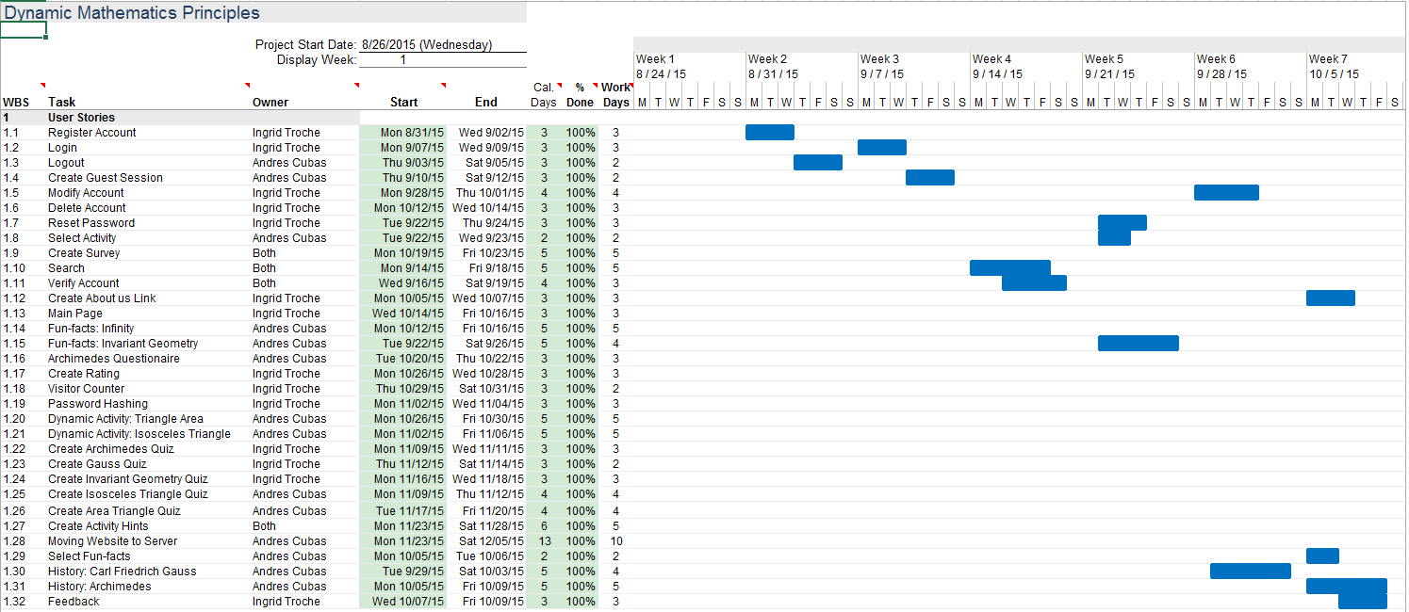
project mANAGEMENT

Slide 4
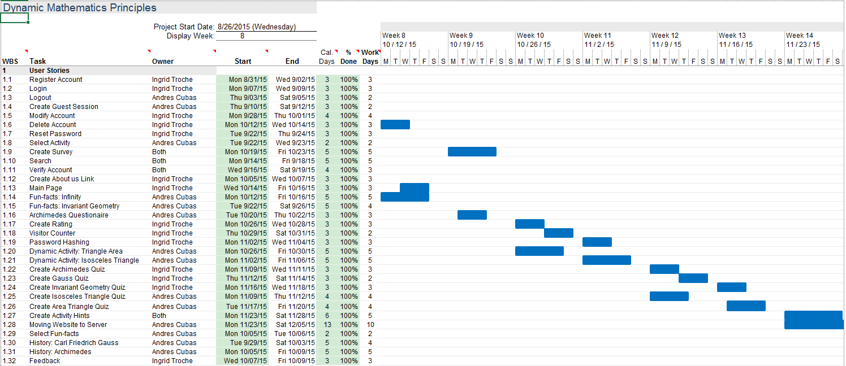
project mANAGMENT

Slide 5
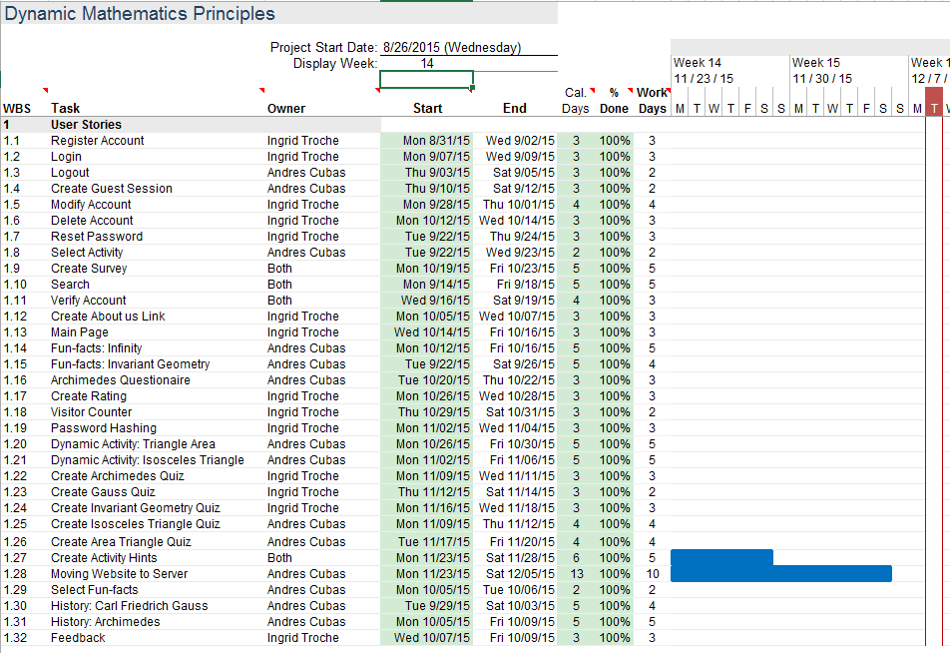
project MANAGMENT

Slide 6
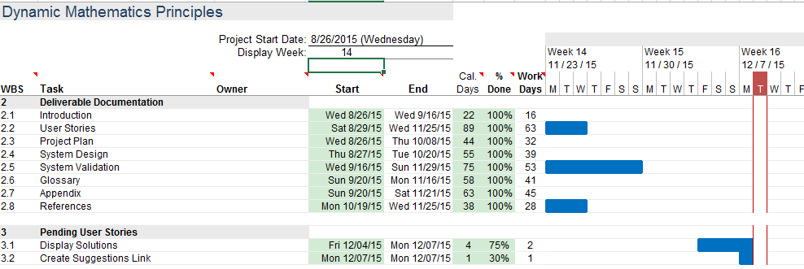
project MANAGEMENT

Slide 7
uSER STORIES
The system shall…
Allow users to register an account
Allow users to login
Allow users to logout
Allow users to modify account
Allow users to delete account
Allow users to send feedback
Allow users to rate activity
Allow users to view About Us page
Allow users to interact with history page

Slide 8
user STORIES
Allow users to answer surveys
Allow users to view hints related to activities
Allow users to interact with the activities
Allow users to take quiz related to the activity

Slide 9
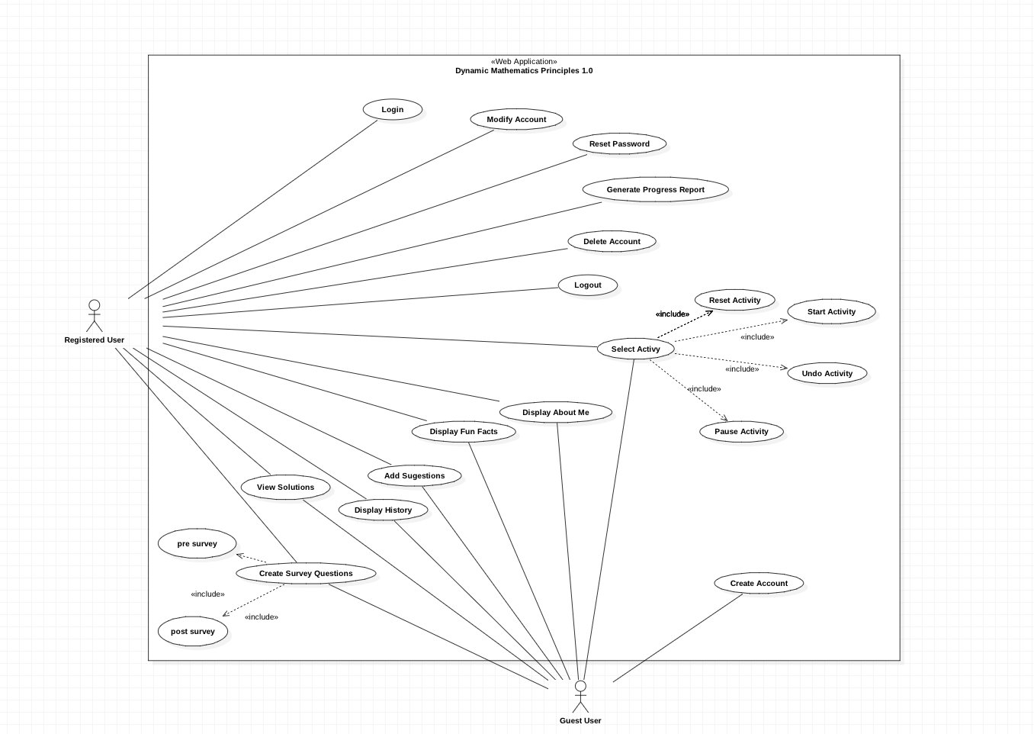
Uml use case model

Slide 10
User story
USER STORY
Allow user to register an account – card#666
USER STORY DESCRIPTION: As a user, I would like to register an account through the website
ACTORS:
User
PRE-CONDITIONS:
User clicks on register account
User input the required information
User clicks on register button
DESCRIPTION:
Use case begins when user clicks on register button on the main page
The system responds by storing user information into our database
Use case ends when the user is able to login to our website

Slide 11
User sTORY
USER STORY
Allow user to sign in to the website– card#668
USER STORY DESCRIPTION: As a user, I will like to sign in to my personalize page
ACTORS:
User
PRE-CONDITIONS:
User clicks on login button
User input the required information
User clicks on login
DESCRIPTION:
Use case begins when user clicks on login button on main page
The system responds by verifying if user exits on the database
Use case ends when the user successfully login to our website

Slide 12
uSER STORY
USER STORY
Allow user to take survey– card#736
USER STORY DESCRIPTION: As a user, I need to take a behavioral survey before interacting with the activities
ACTORS:
User
PRE-CONDITIONS:
User is logged in
User clicks on our survey section
User takes survey and clicks on submit
DESCRIPTION:
Use case begins when user clicks on survey
The system responds displaying questions to the user and saving data in the database
Use case ends when the user successfully submit information in the database

Slide 13
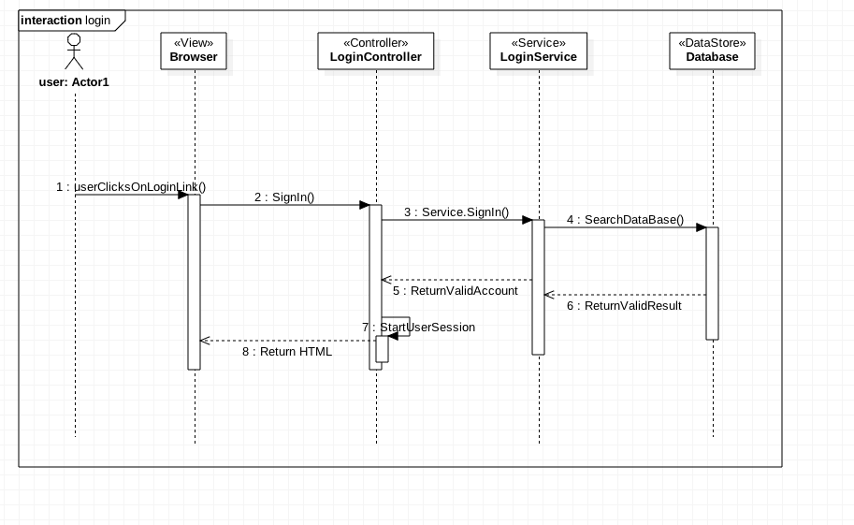
sequence DIAGRAM

Slide 14
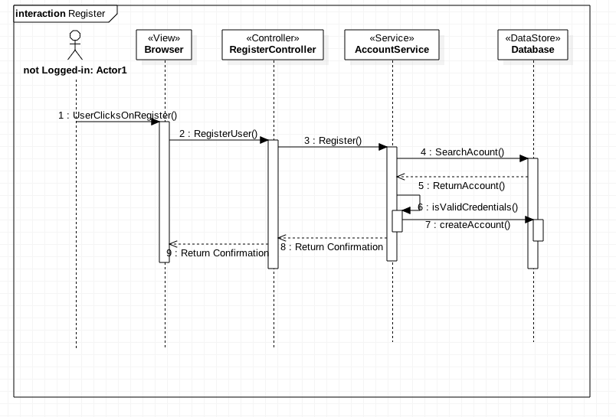
sequence DIAGRAM

Slide 15
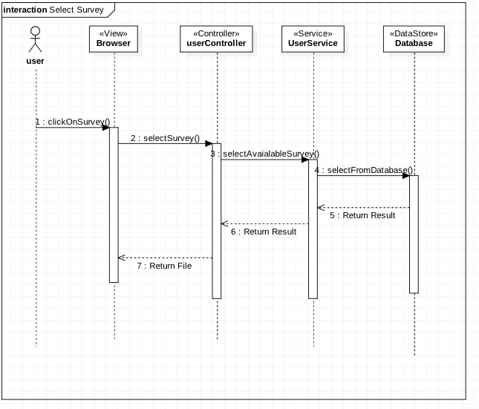
sequence DIAGRAM

Slide 16
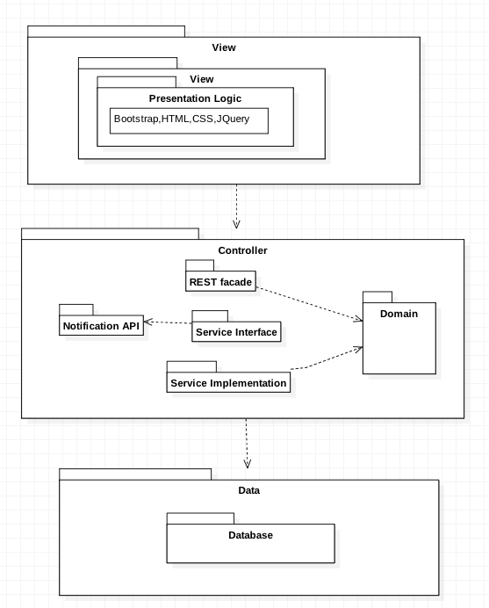
system DESGIN

Slide 17
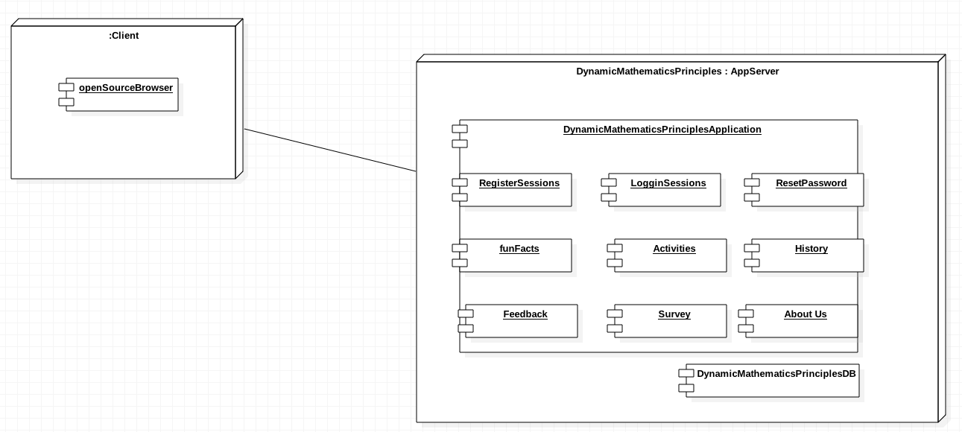
system DEPLOYMENT

Slide 18
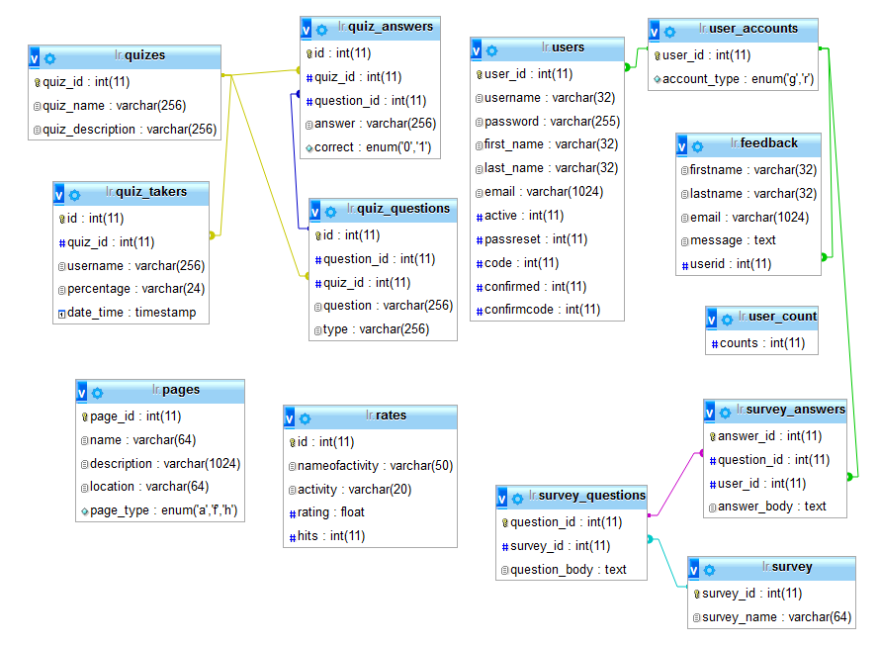
data DESIGN

Slide 19
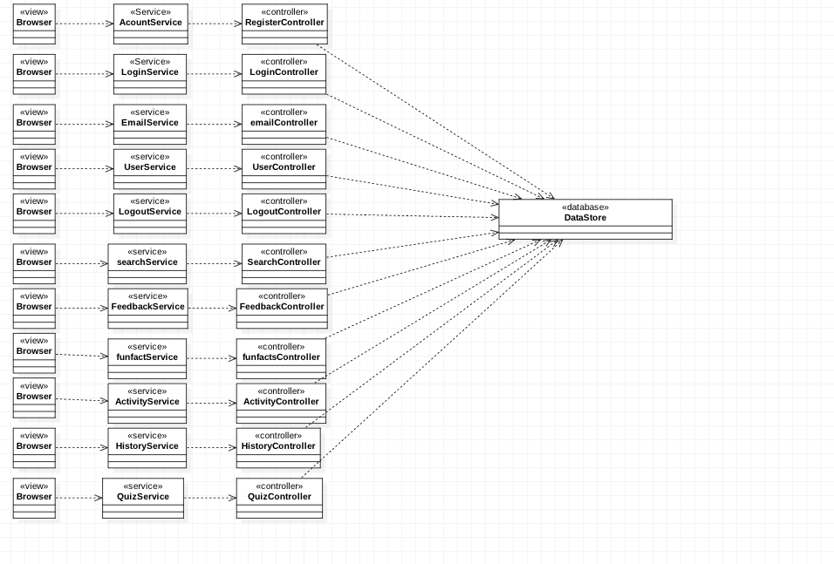
mINIMAL CLASS DIAGRAM

Slide 20
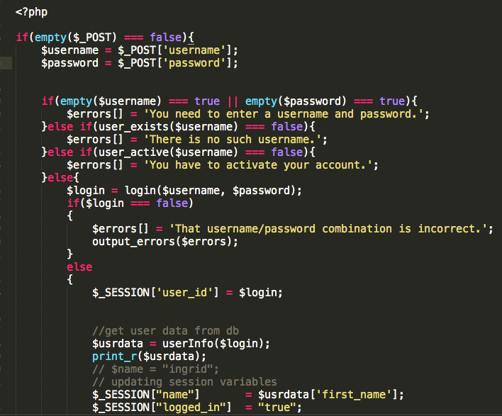
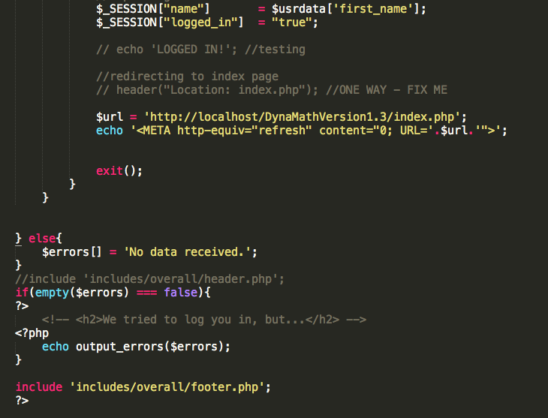
ALGORITHM

Slide 21
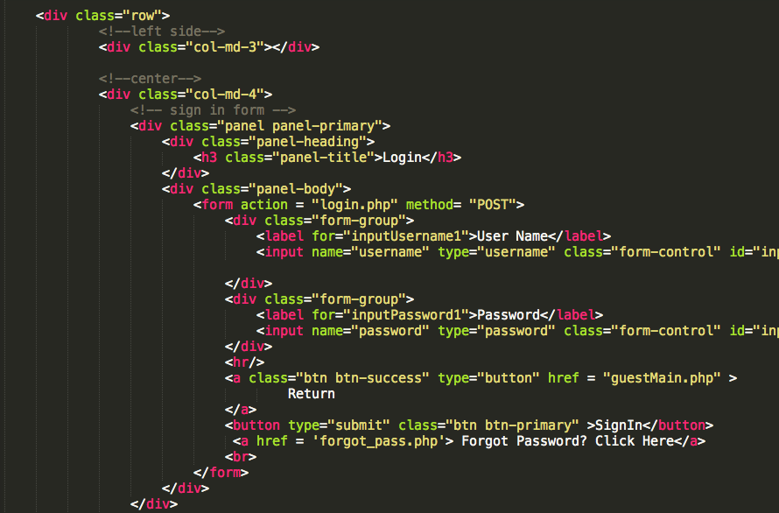
ALGORITHM LOGIN

Slide 22
VALIDATE LOGIN
Test Case ID | DMP 668- SUNNY_01
Purpose | To validate sign in link
Preconditions | The user needs to have a valid account
Input | Click on sign in
Expected Result | Successfully login the user to his/her profile

Slide 23
VALIDATE LOGIN
Test Case ID
Purpose | To validate sign in link
Preconditions | The user needs to have a valid account
Input | The user clicks on sign in
Expected Result | Access denied

Slide 24
Thank you
Questions?

